Slide 1


Slide 2
Introduction to XL Deploy

Slide 3
Outline
Introduce XL Deploy
Installation and Working Demo
Cons of Provisioning Tools

Slide 4
What is XL Deploy?
“XL Deploy is the only application release automation solution that is agentless across all target platforms.”

Slide 5
Advantages of XL Deploy
      Automate and standardize application deployments
      Speed up deployment time
      Greatly reduce the number of errors
      Gain visibility into deployment and environment status
      Enable self-service deployment

Slide 6
XL Deploy Features
Model based, highly scalable approach
Integrates with your environment
Visual status dashboard and reports
Agentless architecture
Enterprise security and centralized audit capabilities
Reliably support global deployments
Automated rollback

Slide 7
Install XL Deploy
Extract the XL Deploy server archive
Install the license
Run the server setup wizard
    a. Windows: run.cmd –setup
    b. Unix: run.sh –setup
  Setup method :
      Answer yes or press Enter to install XL Deploy with default cofiguration
      Answer no to install XL Deploy manually
  Finish the setup and log in : http://localhost:4516

Slide 8
XL Deploy Settings
The server will run with security enabled.
The server will not use secure communication between the XL Deploy graphical user interface (GUI) and the XL Deploy server.
The server will listen on XL Deploy’s standard HTTP port (4516).
The server will use / as the context root.
The server will use a minimum of 3 and a maximum of 24 threads.
Applications can be imported from the importablePackages directory.

Slide 9
How XL Deploy Avoid above problems
Cons in Provisioning Tools
Can’t orchestrate multiple machines
Not suitable for large-scale DevOps
How many more scripts do you want to write and maintain?
You have to force change
Automatically handles all the multi-machine orchestration patterns
Provides a platform for Ops teams to interface with Development
Provides numerous out-of-the-box plugins
It’s easy to adopt for developers.

Slide 10
We need Puppet/Chef
XL Deploy use Puppet and Chef to set up the environments and install the middleware on which their applications will run. XL Deploy then seamlessly deploys the app tier to those environments.

Slide 11
Provisioning tools aren’t ideal
Do you need to orchestrate deployments across multiple machines?
Can you simply re-run all the deployment steps for the app all over again on failure?
Can the developers provide full configuration details?
Can they cope with a rapid application lifecycle?
Do they require agents?
How good is their Windows support?
Can they separate app, middleware, and environment?
Do they offer out-of-the-box content for the application tier?
How well do they integrate with your build and CI tooling?

Slide 12
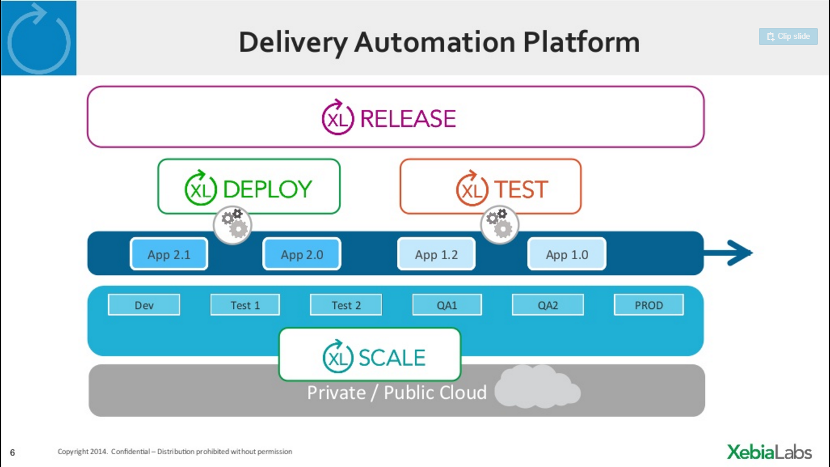

Slide 13
Thank you
Visit us at www.techmahindra.com

